Slide 1
Research Communication Skills
IoT Research Background

Slide 2
Intended Learning Outcomes
By the end of this lesson you will be able to:
  describe a background of IoT research
  find research papers about IoT
  find research papers in your own research area

Slide 3
Outline
IoT Background
IoT Challenges
IoT Research Fields
IoT Journals and Conferences

Slide 4
What is IoT – Internet of Things?

Slide 5
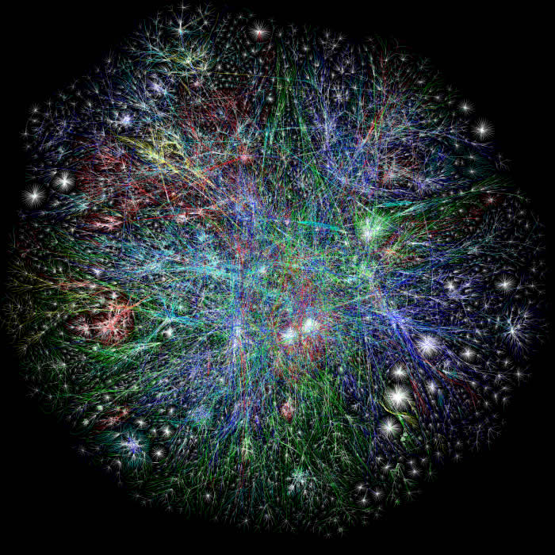

Starting from the Internet
Internet appears everywhere in the world
but it is still a connection between people and people

Slide 6
What is the Internet of Things?
Internet connects all people
Internet of Things connects ….
things

Slide 7
IoT connects all things……
What are these “things”?

Slide 8
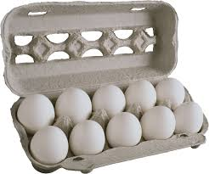
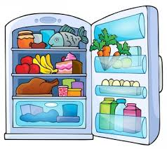


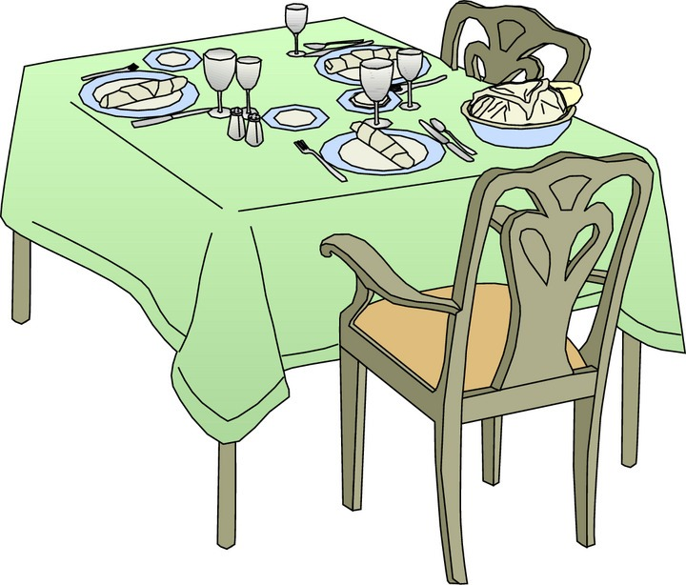

Is it a “thing”?

Slide 9
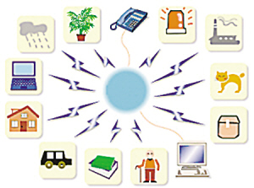
What is the Internet of Things?
Internet connects all people, so it is called “the Internet of People”
IoT connects all things, so it is called “the Internet of Things”

Slide 10
IoT Definition
The Internet of Things (IoT) is the network of physical objects—devices, vehicles, buildings and other items embedded with electronics, software, sensors, and network connectivity—that enables these objects to collect and exchange data.

Slide 11


The Internet of Things (IoT) is the network of physical objects—devices, vehicles, buildings and other items embedded with electronics, software, sensors, and network connectivity—that enables these objects to collect and exchange data.

